Slide 1


Introduction to SOA 12c
What’s in the toolbox?

Slide 2
介绍
新业务项目的步伐持续增长 - 从增加客户自助服务到无缝连接所有后台办公室和现场应用程序。与此同时，迫切需要移动化现有应用，与云融合，并开始将物联网（IoT）设备连接到现有基础设施的最新趋势的发展。当公司独立解决这些新的整合挑战时，使用专业整合工具组的拼凑，快速业务整合，增加应用程序基础设施灵活性和降低成本的原始目标不再可实现。这就是为什么开发Oracle SOA套件12c的原因：通过将移动，云和物联网集成的不同需求统一到一个统一的基于标准的平台来简化IT。

Slide 3
介绍
通过Oracle SOA Suite 12c，您可以： »缩短新项目集成的上市时间
»降低集成成本和复杂性
»高效管理业务和技术变更
»通过根本原因分析提供端到端解决方案监控
»快速响应到业务活动
»确保您的业务基础架构的高可用性和可扩展性

Slide 4
介绍
迫切需要移动启用现有应用程序，与云集成，并开始开发将物联网（IoT）设备连接到现有基础架构的最新趋势。这种情况是为什么开发Oracle SOA套件12c的原因

Slide 5
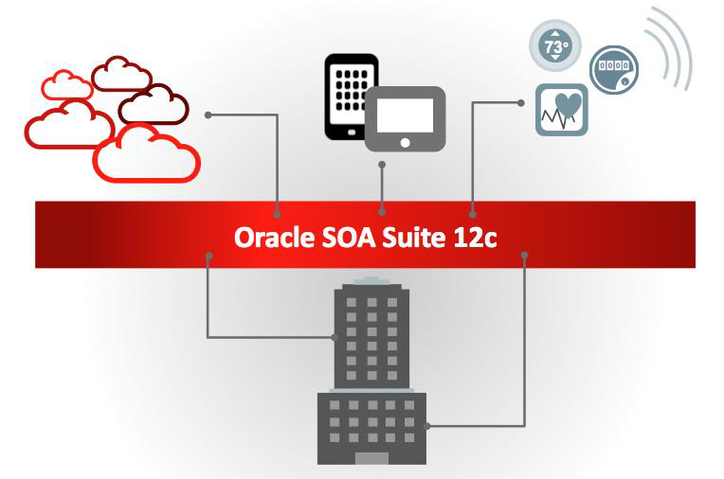
介绍
图1 - Oracle SOA套件的一个关键区别是，通过将云，移动和物联网设备的不同需求与现有的内部部署应用程序相集成，可以进行简化。

Slide 6
Oracle SOA Suite 12c是Oracle融合中间件系列产品的成员。 本白皮书介绍了Oracle SOA套件12c中的各种工具和功能，以及它们如何协同工作以提供全面的SOA解决方案。
Oracle SOA套件12c是一个领先的完整，集成和最佳的平台。 在这些差异化方面，它通过以下方面实现了下一代服务集成功能：
»用于开发服务和组合应用程序的统一工具集。
»一个基于标准的平台，可以通过现代Web应用程序实现服务和易于使用，使企业能够快速，轻松地适应业务和IT环境的变化。
»更好的可视性，控制和分析来控制服务和流程在整个生命周期中的部署，重用和更改。

Slide 7
完整的Oracle SOA套件12c涵盖了您提供强大，灵活和可靠的SOA解决方案所需的所有功能。 以下是关于主要重点领域的套件功能的部分列表：
图

Slide 8

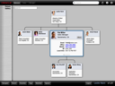




Before you can differentiate & innovate, you need to SIMPLIFY
Notes:
The unfortunate reality in most companies is that they are faced with a sprawling, fragmented, highly siloed IT infrastructure. Equally, the reality of global competition imposes a requirement for a much more flexible, agile IT service function.
So, what can CIOs and IT managers do to bridge the disconnect between business demands and IT’s ability to deliver?
First is the recognition that we can’t simply rip-and-replace existing systems. Which leads to the realization that we must simply get much smarter about how we manage our IT infrastructure. As the brunt of the IT budget (80%+) is spent on maintenance, we have to find an approach that allows us to get more out of these maintenance dollars.

Slide 9

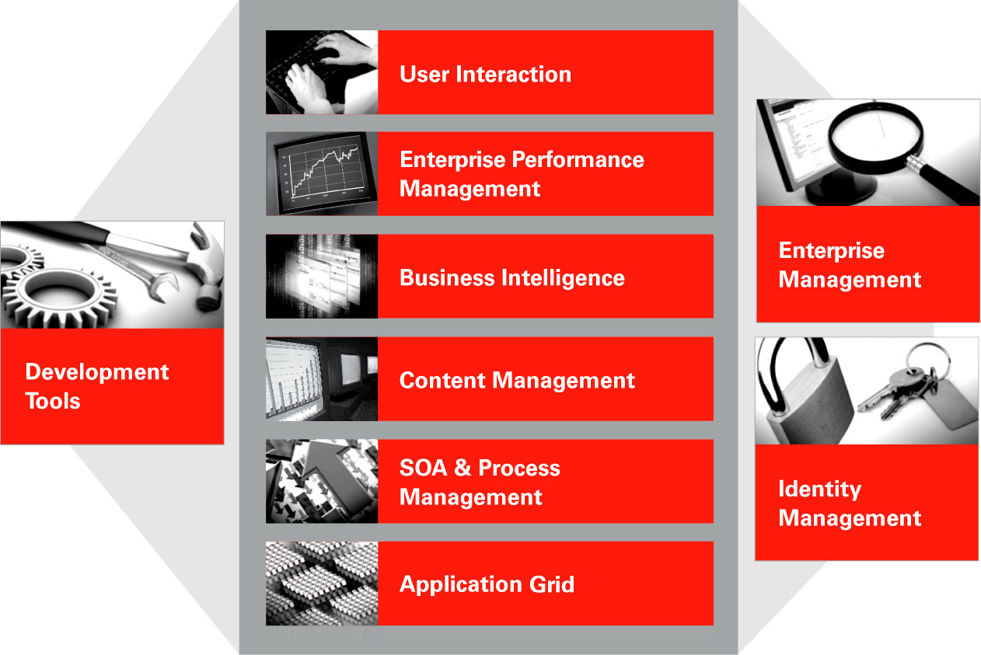
Oracle Fusion Middleware
Applications
Middleware
Database
Infrastructure & Management
Notes:
Oracle Fusion Middleware is a collection of standards-based software products that spans a range of tools and services from J2EE and developer tools, to integration services, business intelligence, collaboration, and content management. Oracle Fusion Middleware offers complete support for development, deployment, and management.
Oracle SOA Suite is an essential middleware layer of Oracle Fusion Middleware. It provides a complete set of service infrastructure components for designing, deploying, and managing composite applications. Oracle SOA Suite enables services to be created, managed, and orchestrated into composite applications and business processes. Composites enable you to easily assemble multiple technology components into one SOA composite application. Oracle SOA Suite plugs into heterogeneous IT infrastructures and enables enterprises to incrementally adopt SOA

Slide 10
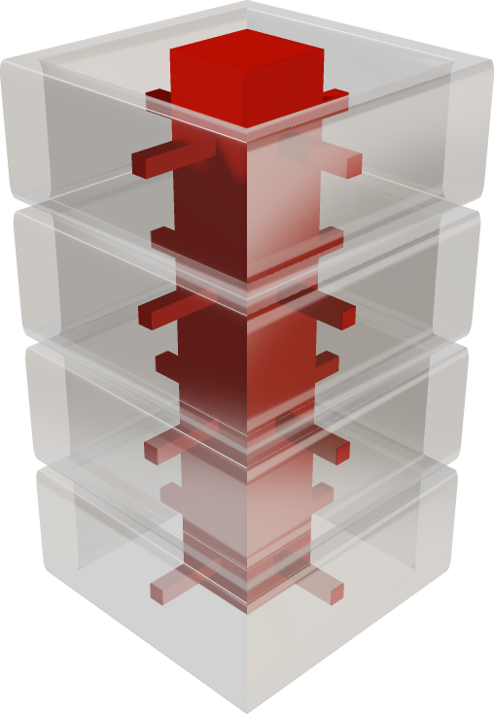
Service-Oriented Architecture (SOA)
Notes:
A service-oriented architecture (SOA) is a style of software design where services are provided to the other components by application components, through a communication protocol over a network. The basic principles of service oriented architecture are independent of vendors, products and technologies
Changing markets, increasing competitive pressures, and evolving customer needs are placing greater pressure on IT to deliver greater flexibility and speed. Today, every organization is faced with predicting change in a global business environment, to rapidly respond to competitors, and to best exploit organizational assets for growth. In response to these challenges, leading companies are adopting service-oriented architecture (SOA) to deliver on these requirements by overcoming the complexity of their application and IT environments.. SOA provides an enterprise architecture that supports building connected enterprise applications to provide solutions to business problems. SOA facilitates the development of enterprise applications as modular business web services that can be easily integrated and reused, creating a truly flexible, adaptable IT infrastructure. You can move and reconfigure pieces, turning your systems into the IT equivalent of Lego blocks.

Slide 11
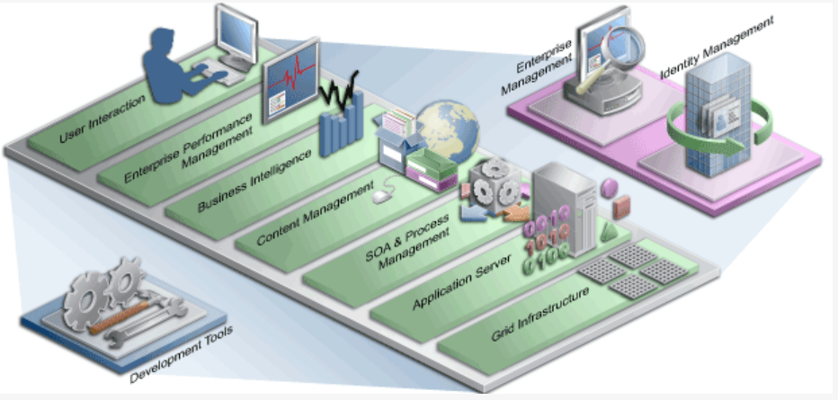
Oracle SOA Suite
Notes:
Oracle Fusion Middleware is a collection of standards-based software products that spans a range of tools and services from J2EE and developer tools, to integration services, business intelligence, collaboration, and content management. Oracle Fusion Middleware offers complete support for development, deployment, and management.
Oracle SOA Suite is an essential middleware layer of Oracle Fusion Middleware. It provides a complete set of service infrastructure components for designing, deploying, and managing composite applications. Oracle SOA Suite enables services to be created, managed, and orchestrated into composite applications and business processes. Composites enable you to easily assemble multiple technology components into one SOA composite application. Oracle SOA Suite plugs into heterogeneous IT infrastructures and enables enterprises to incrementally adopt SOA.
Oracle SOA Suite puts a strong emphasis on standards and interoperability.
What are those ?
Service Component Architecture (SCA) :- The Service Component Architecture (SCA) assembly model abstracts the implementation and allows assembly of components, with little implementation details.
SCA enables you to represent business logic as reusable service components that can be easily integrated into any SCA-compliant application. The resulting application is known as a SOA composite application. The specification for the SCA standard is maintained by the Organization for the Advancement of Structured Information Standards (OASIS).
Service Data Objects (SDO) :- Service Data Objects (SDO) provide a data programming architecture. It provides a standardized view on data, and provides efficient transportation, as well as change capture, in form of a change summary. More specifically, it collects a data graph of related business objects, called DataObjects. This graph tracks the schema that describes the DataObjects. Knowledge is not required about how to access a particular back-end data source to use SDO in a SOA composite application. Consequently, you can use static or dynamic programming styles and obtain connected and disconnected access.
Business Process Execution Language (BPEL):- Business Process Execution Language (BPEL) provides enterprises with an industry standard for business process orchestration and execution. Using BPEL, you design a business process that integrates a series of discrete services into an end-to-end process flow. This integration reduces process cost and complexity..
XSL Transformations (XSLT) :- processes XML documents and transforms document data from one XML schema to another.
Java Connector Architecture (JCA) :- Java Connector Architecture (JCA) provides a Java technology solution to the problem of connectivity between the many application servers in Enterprise Information Systems (EIS).
Java Messaging Service (JMS):- Java Messaging Service (JMS) provides a messaging standard that allows application components based on the Java Enterprise Edition (JEE) to access business logic distributed among heterogeneous systems.
Web Service Description Language (WSDL):- Web Service Description Language (WSDL) file provides a standardized view on the capabilities of a service. Bindings provide the entry points into the composite at runtime.
SOAP over HTTP (SOAP) provides the default network protocol for message delivery.

Slide 12

Mobile Integration
Simplifying Mobility for the Enterprise
ENTERPRISE
MOBILE
ENTERPRISE
Reuse existing application services
Rapid response to new business requests
Fast access to data and services across the Enterprise and external sources
Reliable and solid orchestration platform
SOAP
REST/JSON
Oracle SOA Suite 12c
EXISTING SERVICES
Inventory Check Service
Credit Check Service
Production Service
Customer Status Service
Order Service
Billing Service
Notes:
Customers who want to enable mobile have to do two things right. First they have to get their applications service enabled, this is exactly what Oracle has been doing for years with Oracle SOA Suite and we’ve done a great job to simplify the problem of service enabling business applications. Secondly, they need to mobile enable those services. These may require different standards and different levels of abstractions vs. simply tying these mobile apps directly to existing applications. In Oracle SOA 12c we’ve provided some important enhancements for this use-case to enable these back-end services tied to your business applications to be easily exposed via REST APIs and JSON standards to build mobile apps. This abstraction can also be leveraged as the same underlying infrastructure that ties together your existing on-premises or even your cloud applications.
The end result - faster access to data and services which your customers are seeking through these mobile devices. And secondly, it’s reliable and can support the volumes and scale of traffic associated with this radical change in the industry where customers expect all the services to be available through mobile devices.

Slide 13

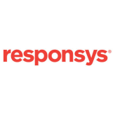













Cloud Integration
Bridging Cloud Applications with On-Premises
Unified integration platform for both cloud and on-premise applications
Point and click modeling for connectivity to cloud apps
Secure connectivity & session management
Cloud Adapter SDK
Oracle SOA Suite 12c
MAINFRAME, Custom Apps
Notes:
Probably the single most ground breaking new capability in SOA 12c is around Cloud Integration support
We’ve provided out of the box support for existing cloud applications as an extension to our adapter framework. The same style of point and click capabilities into a process flow which we expose for integrating Oracle PeopleSoft and SAP are now available for most of the well known Cloud Applications. In addition, we bake into this the best practice of implementing secure connectivity and session management so that you don’t have to.
Today we are happy to announce support for 3rd party Cloud providers such as Salesforce.com, Workday, and Netsuite, in addition to support for Oracle Cloud applications such as Fusion CRM, and Fusion HCM. We will continue to produce more adapters
Finally, we’ve done something in addition to simply releasing the adapters. We’ve also released a cloud Adapter SDK; this makes it easier for our customers and partners to extend the reach of our cloud integration much more broadly in this fast growing ecosystem

Slide 14
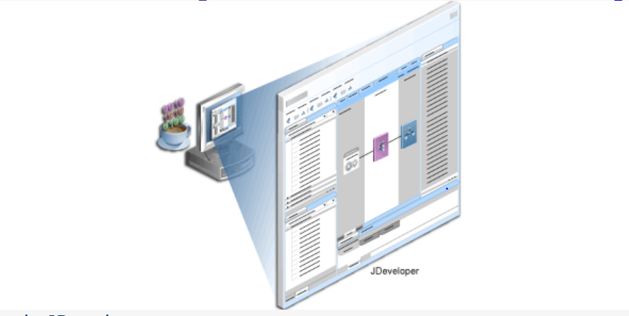
Oracle JDeveloper
Notes:
Oracle JDeveloper is the development component of Oracle SOA Suite. It forms a comprehensive Integrated Service Environment (ISE) for creating and deploying composite applications and managing the composite.
Oracle JDeveloper enables developers to model, create, discover, assemble, orchestrate, test, deploy, and maintain composite applications based on services.
The SOA Composite Editor enables you to create, edit, and deploy services, and also to assemble them in a composite application, all from a single location. These components are integrated together into one application and communicate with the outside world through binding components such as Web services and JCA adapters.
There are two approaches for designing SOA composite applications using SOA Composite Editor
The top-down approach :of building a composite application puts interfaces first and implementation next. For example, you first add BPEL processes, human tasks, business rules, and Oracle Mediator routing services components to an application, and later define the specific content of these service components.
The bottom-up approach : takes existing implementations of service components and wraps them with Web service interfaces for assembly into a composite application. For example, you first create and define the specific content of BPEL processes, human tasks, business rules, and Oracle Mediator routing services components, and later create a SOA composite application to which you add these service components.
Oracle JDeveloper provides many additional editors to design service components: like Oracle BPEL Designer, Oracle Mediator Editor , Human Task Editor & Business Rules Designer:
Oracle BPEL Designer: You can create a BPEL process service component in the SOA composite application of Oracle JDeveloper and then design it by using the BPEL Designer, which is displayed, when you double-click a BPEL process in the SOA Composite Editor.
Oracle Mediator Editor: You can create a mediator service component in the SOA composite application of Oracle JDeveloper, and then design it by using the Mediator Editor, which is displayed when you double-click a Mediator in SOA Composite Editor.
Human Task Editor: You can create a human task service component in the SOA composite application of Oracle JDeveloper and then design it by using the Human Task Editor, which is displayed when you double-click a human task in the SOA Composite Editor.
Business Rules Designer: You can create a business rules service component in the SOA composite application of Oracle JDeveloper and then design it by using the Business Rules Designer, which is displayed when you double-click a business rule in the SOA Composite Editor.

Slide 15
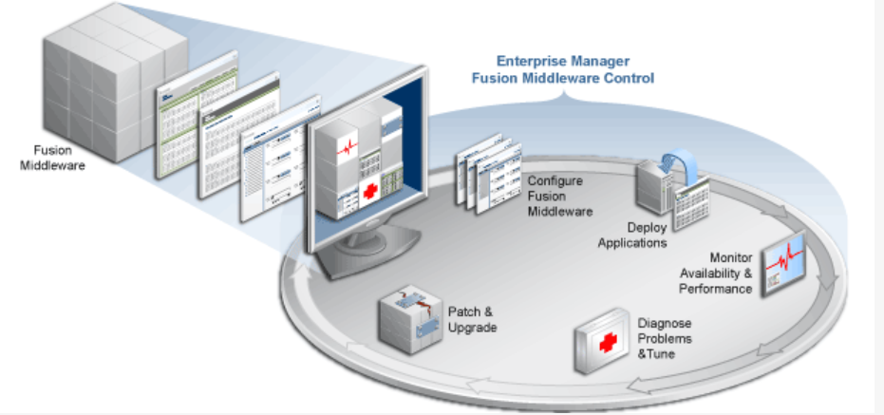
Oracle Enterprise Manager
Notes:
You can configure, monitor, and manage your SOA composite application during run time from Oracle Enterprise Manager Fusion Middleware Control Console. Fusion Middleware Control is a Web browser-based, graphical user interface that you can use to monitor and administer a farm.
You deploy SOA composite applications designed in Oracle JDeveloper to the SOA Infrastructure. The SOA Infrastructure is a Java EE-compliant application running in Oracle WebLogic Server. The application manages composites and their life cycle, service engines, and binding components.
The SOA Infrastructure provides you with access to all deployed SOA composite applications, service engines, service components, business events, and other elements.
Fusion Middleware Control provides a wide variety of administrative and performance data for the SOA components, composite applications, and composite instances within the SOA infrastructure, enabling you to administer and pinpoint issues.

Slide 16
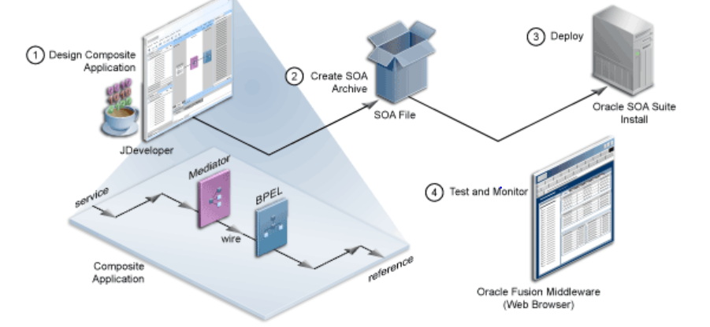
Life Cycle of a SOA Composite Application
Notes:
The basic life cycle of a SOA composite application is as follows:
Use Oracle JDeveloper to design a SOA composite application with various SOA components.
Package the composite application for deployment.
Deploy the SOA composite application to the SOA Infrastructure. The SOA Infrastructure is a Java EE-compliant application running in Oracle WebLogic Server. The application manages composites and their life cycle, service engines, and binding components.
Use Oracle Enterprise Manager Fusion Middleware Control to monitor and manage the composite application for a farm's SOA infrastructure.

Slide 17
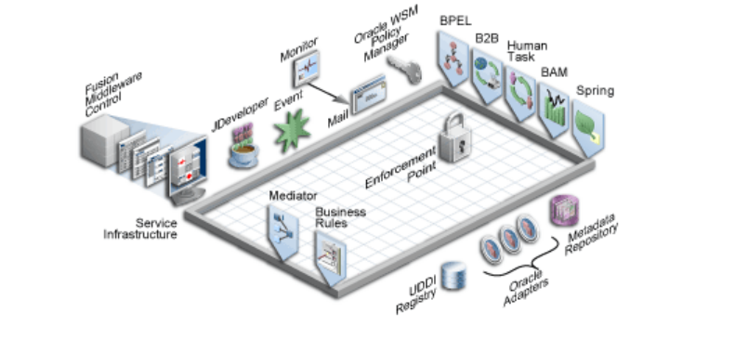
Oracle SOA Suite Components
Notes:
Oracle SOA Suite provides a comprehensive suite of components for developing, securing, and monitoring service-oriented architecture (SOA).
Service components (BPEL process, business rule, human task, spring, and mediator) are the building blocks that you use to construct a SOA composite application.
The Service Infrastructure provides the internal message transport infrastructure capabilities for connecting service components and enabling data flow. Service engines for the components process the message information received from the Service Infrastructure.
Oracle Business Activity Monitoring consumes data transported over the Service Infrastructure, providing powerful business insight capabilities.
So all these components what you see comprise Oracle SOA Suite installation:
Service Infrastructure
Oracle Mediator
Oracle Adapters
Business Events and Events Delivery Network
Oracle Metadata Repository
Oracle Business Rules
Oracle WSM Policy Manager
Oracle BPEL Process Manager
Spring Context
Human Workflow
Oracle Business Activity Monitoring
Oracle User Messaging Service
Oracle B2B
Oracle JDeveloper
Oracle Enterprise Manager
Oracle Service Bus & Oracle Complex Event Processing are included with Oracle SOA Suite, but available as a separate download
Both the Oracle Service Bus and the Service Infrastructure share common components, including Oracle Adapters, Oracle Metadata Repository, and the UDDI registry. The UDDI registry is available with the Oracle Service Registry, which is a separately licensable component.

Slide 18
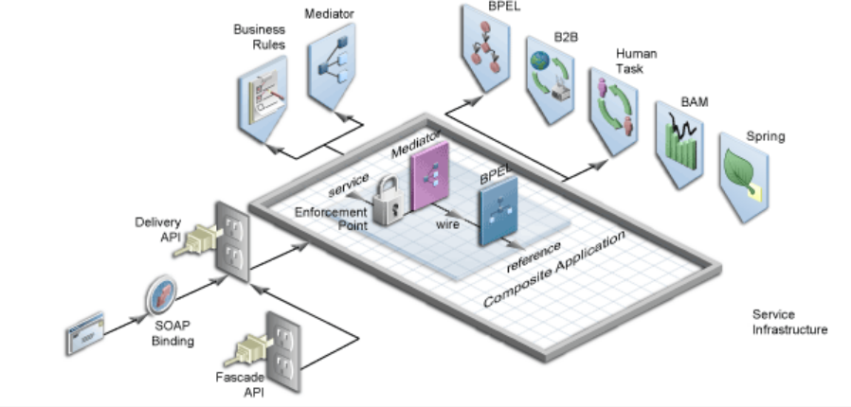
Service Infrastructure
Notes:
We said Service Infrastructure provides the internal message routing infrastructure capabilities for connecting components and enabling data flow now what does it mean
Receives messages from the service providers or external partners through SOAP binding components, adapters, or the delivery API in the form of XML.
Routes messages based on the composite definition to the appropriate service engine.
Service Infrastructure like Oracle Mediator provide capabilities for :
Routing services to provide data movement
Routing rules to specify routing, document transformation, and filtering
Subscriptions to business events
Unified error handling and exception management

Slide 19
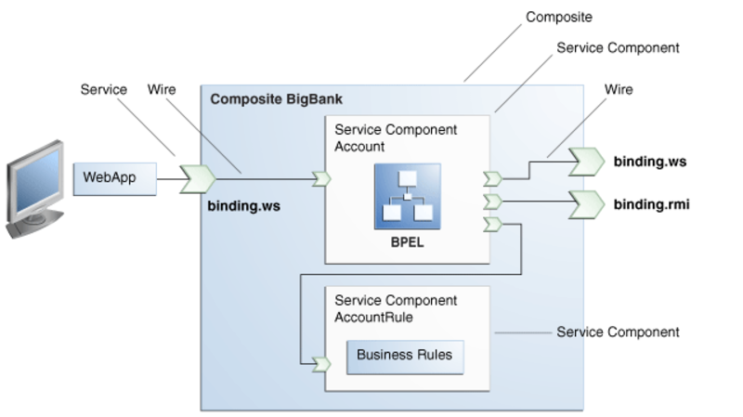
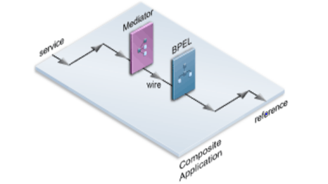
SOA Composite Application Architecture
Notes:
A SOA composite is an assembly of services, service components, and references designed and deployed together in a single application. Wiring between the service, service component, and reference enable message communication. The composite processes the information described in the messages.
You can see in the deck provides an example of a composite that includes a mediator service component and a BPEL service component, an inbound service binding component, and an outbound reference binding component.
Service Components
Service components are the building blocks of a SOA composite application. Each service component is hosted in its own service engine container. Messages sent to the service engine are targeted at specific service components. For example, a message targeted for a BPEL process is sent to the BPEL service engine. Service engines process the message information received from the .
There are 4 service components.
BPEL processes provide process orchestration and storage of synchronous or asynchronous process. You design a business process that integrates a series of business activities and services into an end-to-end process flow
Business rules enable you to design a business decision based on rules.
Human tasks provide workflow modeling that describes the tasks for users or groups to perform as part of an end-to-end business process flow.
Mediators route events (messages) between different components.
There is a corresponding service engine of the same name for each service component. All service engines can interact together in a single composite.
Services
Services provide the outside world with an entry point to the SOA composite application. The WSDL file of the service tells its capabilities to external applications. These capabilities are used for contacting the SOA composite application components. The binding connectivity of the service describes the protocols that can communicate with the service, for example, SOAP/HTTP or a JCA adapter.
References
References enable messages to be sent from the SOA composite application to external services in the outside world.
Wires
Wires enable you to graphically connect the following components in a single SOA composite application for message communication:
Services to service components
Service components to other service components
Service components to reference

Slide 20
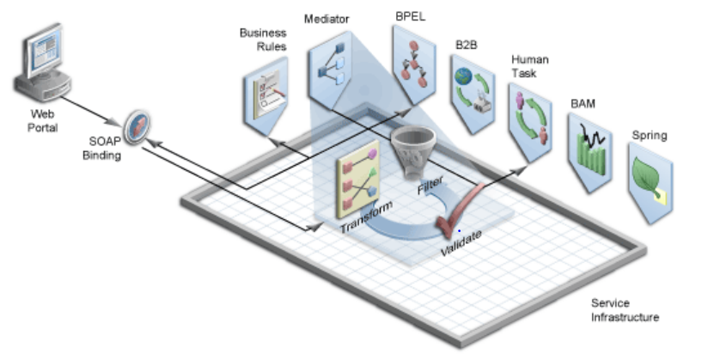
Oracle Mediator
Notes:
Oracle Mediator routes data from service providers to external partners.
In addition, it can subscribe to and publish business events.
Using Oracle Mediator, you create routing services and rules for them
A routing service is the key component for moving a message across the enterprise service bus – from its entry point to its exit point
The rules determine how a message instance processed by the routing service gets to its next destination.
Using the rules, Oracle Mediator can perform :
Routing: Determines the service component (BPEL process, business rule, human task, and mediator) to which to send the messages.
Validate: Provides support for validating the incoming message payload by using a schematron or an XSD file.
Filter: If specified in the rules, applies a filter expression that specifies the contents (payload) of a message be analyzed before any service is invoked.
Transformation: If specified in the rules, transforms document data from one XML schema to another, thus enabling data interchange among applications using different schemas.
During runtime, Oracle Mediator evaluates routing rules, performs transformations, applies optional time delays, and either invokes another service or raises another business event.

Slide 21
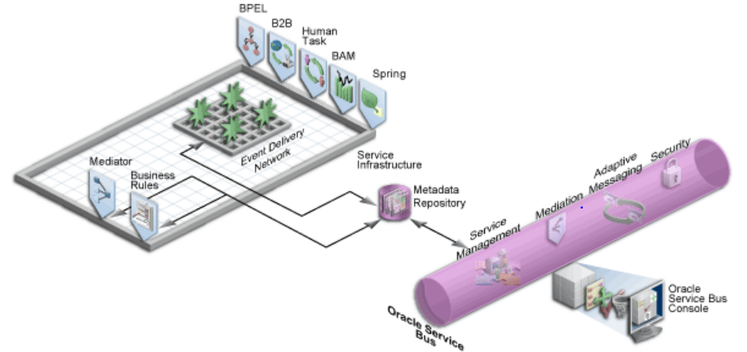
Oracle Metadata Repository
Notes:
Oracle Metadata Repository
The Oracle Metadata Repository (MDS) stores business events, rulesets for use by Oracle Business Rules, XSLT files for Oracle Service Bus and Oracle Mediator, XSD XML schema files for Oracle BPEL Process Manager, WSDL files, and metadata files for Complex Event Processing.

Slide 22
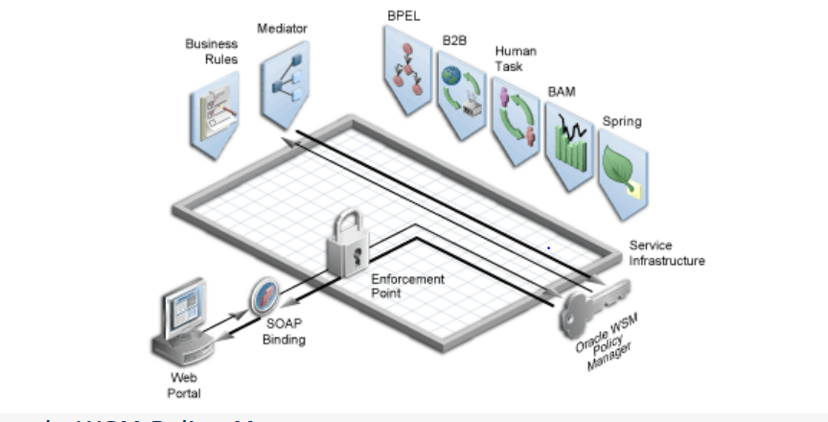
Oracle WSM Policy Manager
Notes:
Oracle WSM Policy Manager provides the infrastructure for enforcing global security and auditing policies in the Service Infrastructure. By securing various endpoints and setting and propagating identity, it secures applications. Oracle WSM Policy Manager provides a standard mechanism for signing messages, performing encryption, performing authentication, and providing role-based access control
In addition, Oracle WSM Policy Manager collects monitoring statistics with information about the quality, uptime, and security threats and displays them in a Web dashboard. As a result, Oracle WSM Policy Manager provides better control and visibility over Web services.

Slide 23
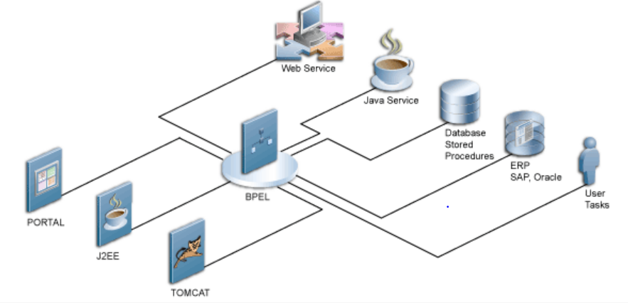
Oracle BPEL Process Manager
Notes:
Oracle BPEL Process Manager provides the standard for assembling a set of discrete services into an end-to-end process flow, radically reducing the cost and complexity of process integration initiatives. Oracle BPEL Process Manager enables you to orchestrate synchronous and asynchronous services into end-to-end BPEL process flows.
You integrate BPEL processes with external services (known as partner links). You also integrate technology adapters and services, such as human tasks, transformations, notifications, and business rules within the process.

Slide 24
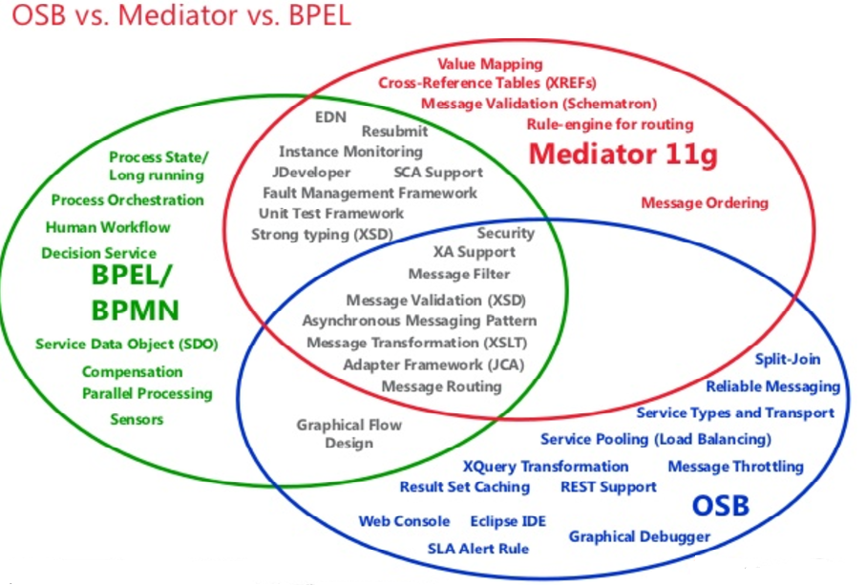
BPEL vs Oracle Service Bus/Mediator

Slide 25
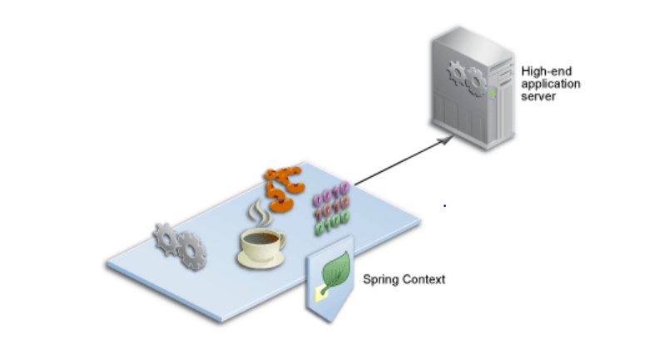
Spring Context
Notes:
Oracle SOA Suite provides support for the spring framework functionality of the WebLogic Service Component Architecture (SCA) of Oracle WebLogic Server. Spring is a popular application framework that enables developers to quickly and easily create high quality applications for deployment into high-end application servers
You can use the spring framework to create Java applications using plain old Java objects (POJOs) and expose components as SCA services and references. In SCA terms, a WebLogic spring framework SCA application is a collection of POJOs plus a spring SCA context file that wires the classes together with SCA services and references.
Oracle SOA Suite provides a spring context service component that enables you to use Java interfaces instead of WSDL files in SOA composite applications. You can also integrate components that use Java interfaces with components that use WSDL files in the same SOA composite application. For example, you can have a spring context service component invoke an Oracle BPEL Process Manager service component or an Oracle Mediator service component invoke a spring context service component or Enterprise JavaBean.

Slide 26
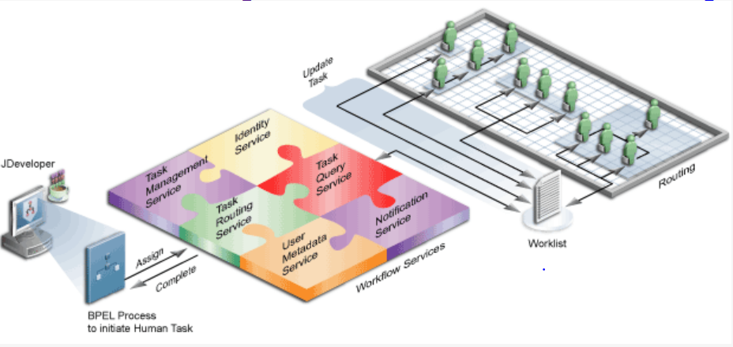
Human Workflow
Notes:
Many end-to-end business processes require human interactions with the process. For example, humans may be needed for approvals, exception management, or performing activities required to advance the business process
Oracle SOA Suite provides Human workflow component for this purpose
Using Human Workflow component we can
Perform Human interactions with processes, including assignment and routing of tasks to the correct users or groups.
Presentation of tasks to end users through a variety of mechanisms, including a worklist application (Oracle BPM Worklist).
Organization, filtering, prioritization, and other features required for end users to perform their tasks.
Reports, reassignments features required by supervisors and business owners to manage the performance of tasks.
You can see that
A BPEL process invokes a human task activity when it needs a human to perform a task.
A human task activity creates a task in the human task service component.
The human task service component uses workflow services to perform a variety of operations in the life cycle of a task, such as querying tasks for a user, retrieving metadata information related to a task,
The human task service component presents tasks to users through a variety of channels, such as Oracle BPM Worklist, email, portals, or custom applications. Oracle BPM Worklist, a role-based application that supports the concept of supervisors and process owners, and provides functionality for finding, organizing, managing, and performing tasks.

Slide 27
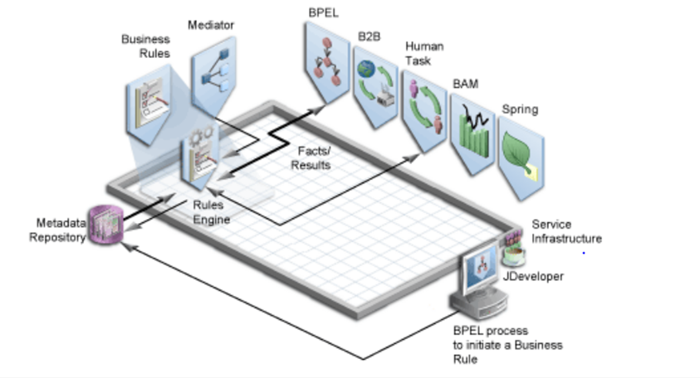
Oracle Business Rules
Notes:
Oracle Business Rules, initiated by a BPEL process service component, enable dynamic decisions at runtime allowing you to automate policies, constraints, computations, and reasoning while separating rule logic from underlying application code. In addition, the human task and mediator service components can make use of rules for dynamic routing. A mediator service component can use a business rule for routing messages, and a human task can use a business rule for routing assignments. The Oracle Metadata Repository (MDS) stores the rulesets for Oracle Business Rules.
Oracle Business Rules provide more agile rule maintenance and empowers business analysts with the ability to modify rule logic without programmer assistance and without interrupting business processes.

Slide 28
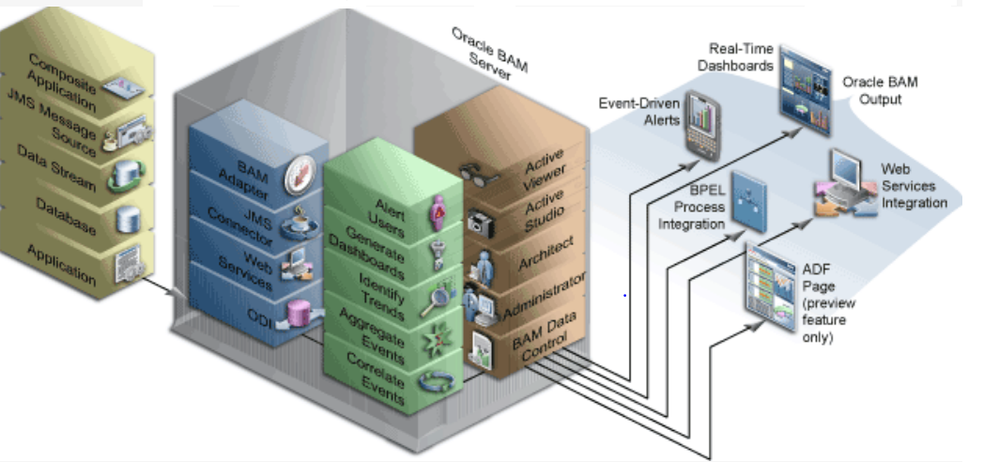
Oracle Business Activity Monitoring
Notes:
Oracle Business Activity Monitoring (Oracle BAM) is a complete solution for building real-time operational dashboards and monitoring and alerting applications over the Web.
Using this technology, business user gain the ability to build interactive, real-time dashboards and proactive alerts to monitor their business services and processes
It enables business operation workers and managers to:
1)Monitor business processes and services in real-time
2)Analyze events as they occur by correlating events, identifying trends as they emerge, and alerting users to bottlenecks, exceptions, and solutions to business problems
3)Act on current conditions with event-driven alerts, real-time dashboards, BPEL processes, and Web services integration, 4)Enabling quick changes or corrective action to business processes
The graphic depicts the Oracle Business Activity Monitoring active data architecture for dynamically moving real-time data to end users through every step of the process. It shows various mechanisms to feed data into Oracle BAM. Oracle BAM processes incoming data and analyzes events. Oracle BAM Web Applications, including Active Viewer, Active Studio, Architect, Administrator, enable users to build Oracle BAM schema, dashboards, and alerts. BAM Data Control enables developers to create ADF pages with active data content. Oracle BAM and its applications then provide output to users.

Slide 29
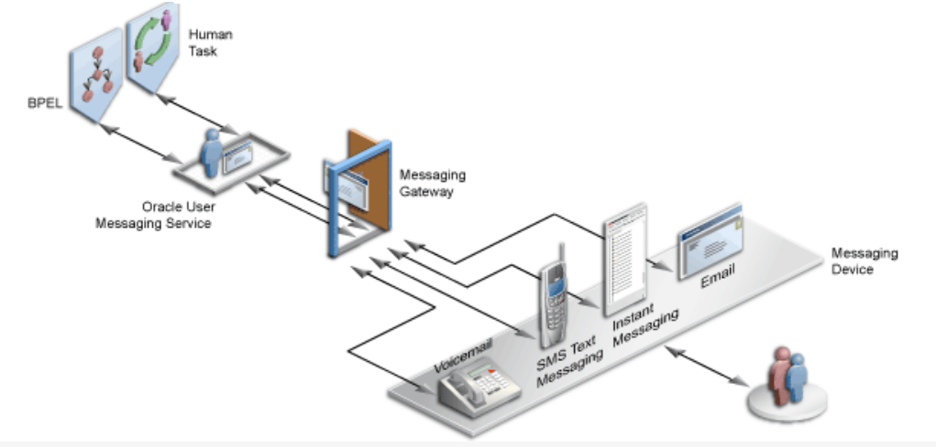
Oracle User Messaging Service
Notes:
Oracle User Messaging Service provides a common service responsible for sending out messages from applications to devices. It also routes incoming messages from devices to applications.
You can easily send outgoing notifications from a BPEL process flow or invoke outgoing and incoming messages for tasks assigned to users from a human task.

Slide 30
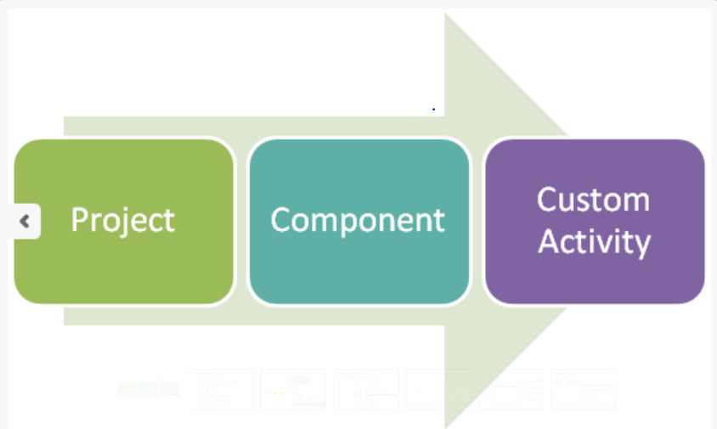
SCA Composite using templates
In 12c it is easier then ever to re-use at all levels within a SCA composite. Using the build-in template support you can kick-start a SCA Composite or add reusable components.
There are three types of templates
SOA Project template :- Project template contains full project along with all the references, artifacts etc. By using this project template we can build a new project which is derived from already existing project, this make developer task really easy
Component template:- This template contains service component. It also contains all reference components and resources
Custom Activity template :- This template contains a scope activity of a BPEL process which may include assign, transform, invoke, and receive and partner link

Slide 31
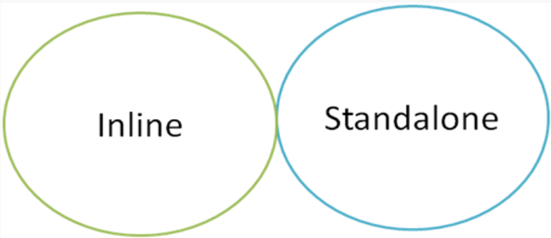
Subprocesses
Sub Process act like a bundle which contain a piece of BPEL code which we can re-use inside same BPEL or different BPEL in same composite
Sub process contains fragment of BPEL code. Benefit of sub process is that it increases developer productivity and chances of human error got reduced
There are mainly two types of sub process in 12c
Inline Sub-Process:As name suggests this sub process is in line to parent BPEL process means this can’t be used outside parent BPEL process. Inline sub process contains group of activities which we can re-use within one BPEL process only. This sub process is not visible in composite view as this is part of parent BPEL. This sub process is visible in palette under sub process. We need to use call activity to call this sub process inside BPEL process
Standalone Sub-Process:- As name suggests this sub process act as standalone inside one composite. Standalone sub process is similar to inline sub process, except we can use it outside of parent process. This sub process contains group of activities that can be re-used across other BPEL processes. Similar to inline sub process we use call activity to invoke standalone sub process

Slide 32
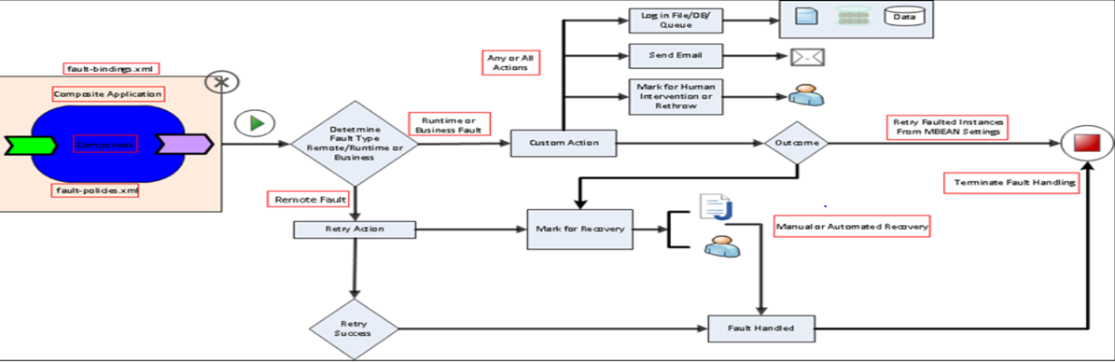
Fault Handling
Notes:
Have a look at the diagram to understand a mechanism to throw a fault from a service composite, identify the fault type and then take necessary action.
Coming to Fault Handling in a composite there are primarily two types of faults
Business faults – Occurs when application executes THROW activity or an invoke receives fault as response. Fault name is specified by the BPEL process service component. This fault is caught by the fault handler using Fault name and fault variable.
Runtime faults – Thrown by system. Most of these faults are provided out of the box. These faults are associated with RunTimeFaultMessage and are included in http://schemas.oracle.com/bpel/extension namespace.
Oracle SOA Suite gives us an option of configuring fault and fault actions using policies. This means that we can create policies in response to a specific type of exception. Policies are defined in a file that by default is called fault-policies.xml
Policies for fault handling consist of two main elements:
The fault condition that activates the policy block—we specify what type of fault(s) the policy is relevant for. We can then apply even more finer grained policy and actions based on error codes, error messages etc.
The action(s) that should be performed when the condition is satisfied. An action for an fault may be to retry it for a certain number of time at a specified interval, or to mark it in recovery for human intervention, use a custom Java code or simply to throw the fault back. If the fault is rethrown then if we have specified any explicit ‘catch’ block in our BPEL process that will be executed.
It should also be noted that fault policies need to be explicitly associated with composites, components, or references. This is done in a fault-bindings.xml file. Fault bindings link the composite, specific components in the composite, or specific references in the components on the one hand to one of the fault policies on the other.
we have to add two properties in the composite.xml to let the composite know about them
<property name=”oracle.composite.faultPolicyFile”>fault-policies.xml></property> <property name=”oracle.composite.faultBindingFile”>fault-bindings.xml></property>
We can use different names and locations for the fault policies and fault bindings files, by setting the properties oracle.composite.faultPolicyFile and oracle.composite.faultBindingFile in the composite.xml to configure these custom files.
For example we can refer to these files even from the MDS.
<property name=”oracle.composite.faultPolicyFile”>oramds://apps/policy/fault-policies.xml></property> <property name=”oracle.composite.faultBindingFile”>oramds://apps/policy/fault-bindings.xml></property>

Slide 33


Developer Productivity

Slide 34

For the Developer
Quick Start to Develop
Connectivity
Message Mapping Support
Reusability
Debugging and Testing
Continuous Delivery
Web-based Development Console

Slide 35
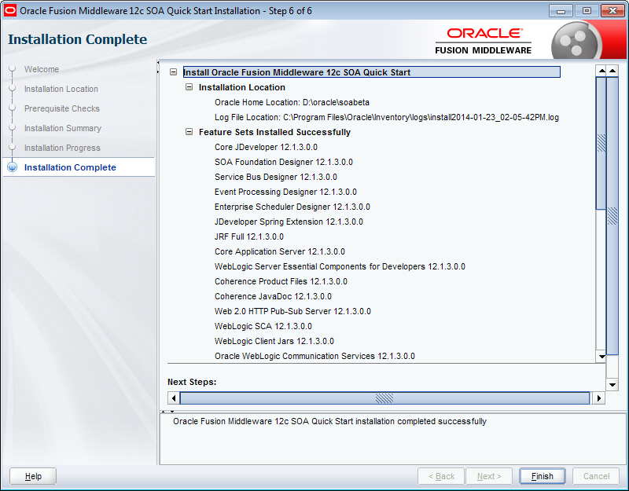
Get Started, Get Productive
Quick-start installation
Free for the Developer
Single Package Installer
Install and setup to “Hello World” in 30 minutes or less

Slide 36
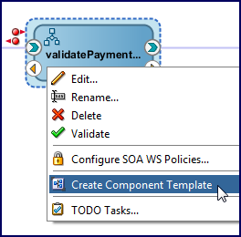
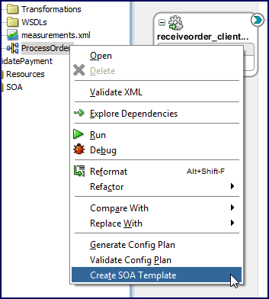
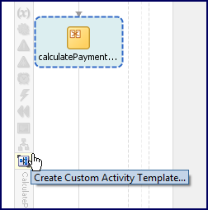
SOA ‘Starter’ Templates
Reuse at all levels
Component
‘Starter’ Templates
Re-usable part of a SOA project
Fully editable
Store in MDS
Three types:
SOA Project Template
Component Template
Custom Activity Template
How to create a template?
Project
BPEL Activity
Notes:
In SOA 12c, we have the capability to create templates from SOA composites, from service components and from scope activities in the BPEL process itself.
A SOA project template would be, for example, a SOA composite with adapters or potentially other SOA components like mediators, BPEL, human tasks, business rules, or both inbound and outbound adapters.
All of those configurations can be saved as a template into the design time metadata store and then re-used.
This allows us to then create new SOA composites based on the template and then make changes as needed.
We can do the same with the individual service components.
For example, you can re-use the SOA mediator or BPEL process you have created and configured and make them into a template that can be re-used in the same or other service composites. We can also do the same with a scope activity in a BPEL process. If you have a BPEL process and a scope activity with various activities like assigns, invokes, receives, local variables, catch handling and compensation, you can bundle these together into a template other developers can use to create SOA BPEL processes
Using templates makes it very easy to standardize and re-use quality designs across different developers, different teams and different composites.
Templates are copies, not references, so changes to the templates after they have been used will not affect composites, components or scope activities that have been created using these templates.
Also, in the current version of SOA Suite, these templates cannot be edited and versioned. We would need to save new versions with a different template name.

Slide 37
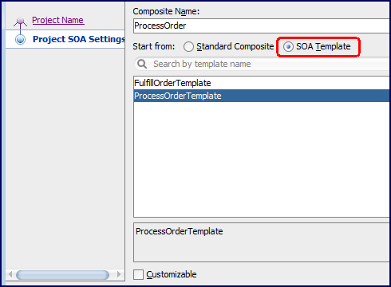
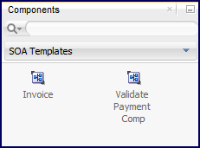
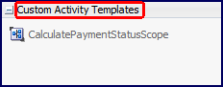
SOA ‘Starter’ Templates
Re-use at all levels
How to consume a template?
Project
Project template accessible at the time of new project creation
Automatically discover in the component palette
Component Template
Custom Activity Template
Share and re-use from MDS
Component

Slide 38
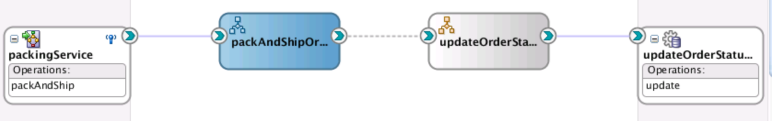
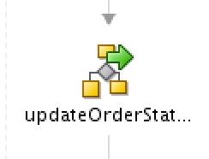
BPEL Sub-processes: standalone and inline
Allows business logic to be modularized and reused
Permits access of data in parent process
Improves performance and manageability
Compensation and fault handling inherited from calling process
Run time memory holds only a single copy of the reused code
Notes:
The Oracle SOA 12c is bringing us a lot of new nice features and one that catches every ones attention is the SubProcess feature.
The SubProcess eliminates the need for writing the same code more than once on the same process
BPEL subprocesses come in two flavors – standalone, and inline.
About the standalone subprocess:
• This is a fragment of a BPEL process, which includes a number of activities that will be re-used across a number of other BPEL processes.
• The standalone subprocess doesn’t have an interface and can only be called from another BPEL process, but it can have partner links.
• In the composite view, the wire to a subprocess is shown as dotted line to indicate that this is not a wire between actual components.
• We introduced a new “call” activity in BPEL to be able to invoke a subprocess.
• Standalone subprocesses are visible in the component palette.
So hee benefits of Subprocess:
Reusability of BPEL code. Now don't have to write same code multiple times, just create subprocess and call that subprocess where ever you want.
You don't have to change the logic at multiple times, just change in the sub process i.e. at one place only.
Code looks more modularized and easy to understand by any other stakeholder.
About the inline subprocess:
• For groups of activities that are re-used within just one BPEL process, you can use an inline subprocess.
• It’s part of the parent BPEL process code and not visible in the composite view.
• We also use a call activity for this.
• You can either define parameters to be set or use the process parameters.
• The inline subprocess is visible in the BPEL palette.
• Activities must be in a scope in order to be converted into a subprocess
• At run-time, the subprocess code is re-entrant and re-usable – only one copy is stored in memory, even if it is called multiple times.

Slide 39
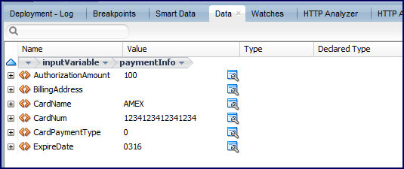
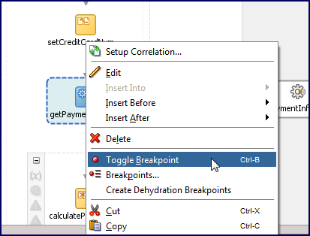
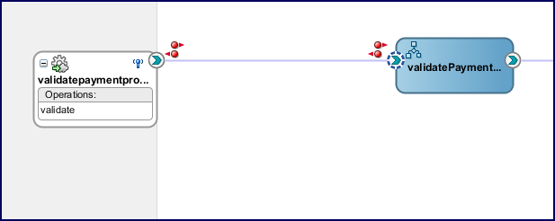
Integration Debugger
Same experience across BPEL, Service Bus
Local or remote debugging
View payloads (including non-XML)
Set break points
Change variables while debugging – BPEL & Service Bus
Notes:
In SOA Suite 12, we have the ability to set breakpoints in the composite Editor, BPEL process and Service Bus pipeline.
You’re able to stop at breakpoints, look at the data, step into, step out and so on.
In a BPEL process, you’re also able to change the value of a variable while debugging.
Set breakpoints in the composite by right clicking on an interface and create a Request or Reply Breakpoint or both.

Slide 40
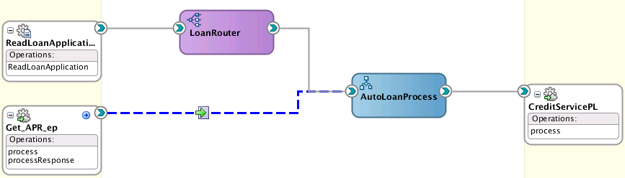
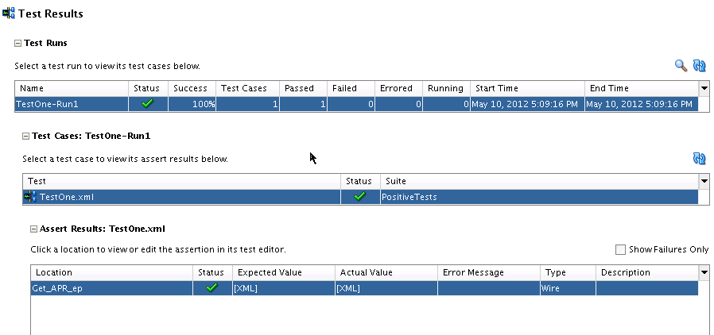
SOA Tester
Develop & test without switching to EM
Auto generate input message or load from sample
Assert request, response, and fault messages
Emulate response & fault messages
Delayed emulation
Accelerate execution using fast forwards
Notes:
12c SOA Tester:
Develop & test without switching to EM
Auto generate input message or load from sample
Assert request, response, and fault messages
Emulate response & fault messages
Delayed emulation
Accelerate execution using fast forwards

Slide 41
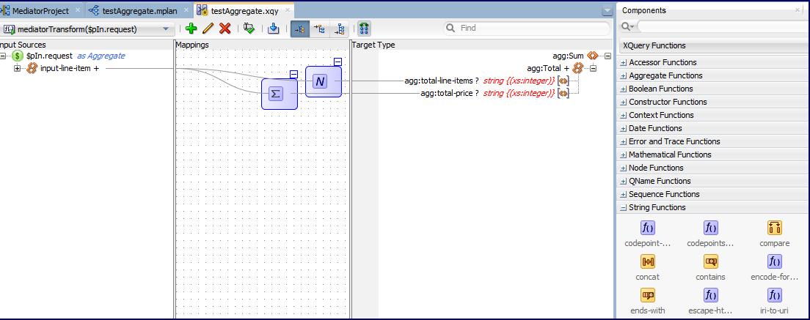
XQuery Mapper
XSLT or XQuery? It’s the developer’s choice
100% support for XQuery 1.0
XPath 2.0 plus user defined functions
Library & main modules
User friendly and consistent with XSLT mapper interface
Test framework - ‘Run XQuery’
Built for reuse in SOA & Service Bus

Slide 42
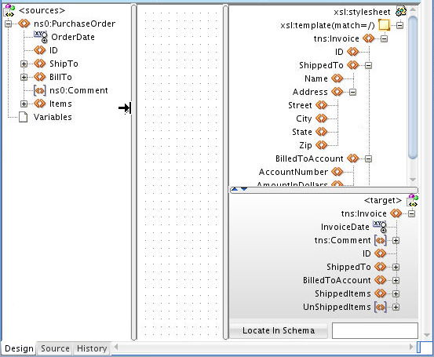
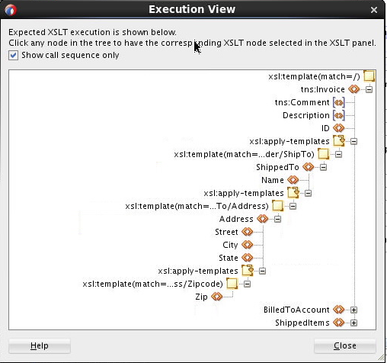
XSLT Mapper
Better support for very large and complex stylesheets
Multi-template support
Source & target structures from sample XML
XSLT execution sequence
Testing capabilities

Slide 43
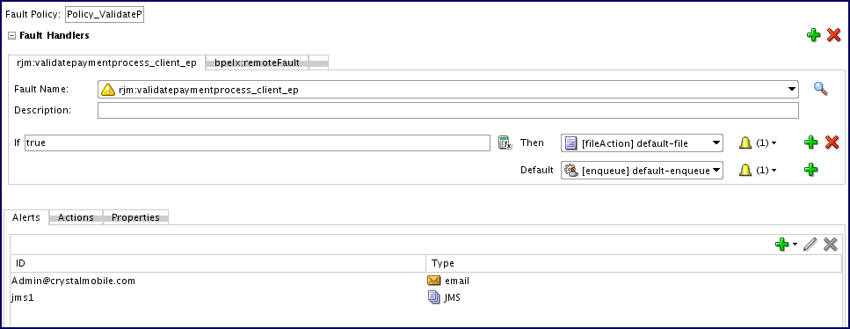
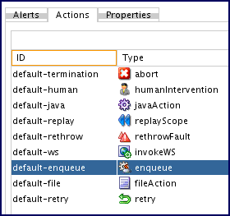
Fault Policy Editor
Design & Edit Fault Policies
Catches all faults - business and runtime
Fault policy includes multiple faults, corresponds Actions and Alerts

Slide 44
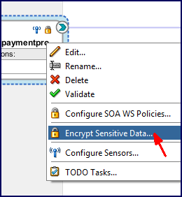
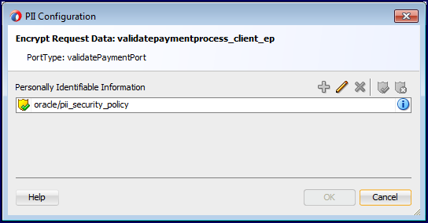
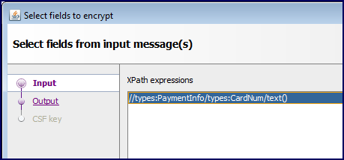
Encrypt/Decrypt Personally-Identifiable Info (PII)
Protect sensitive data from appearing as clear text in admin consoles
Encrypt/Decrypt specific fields in messages
Available in SOA and Service Bus

